Slide 1
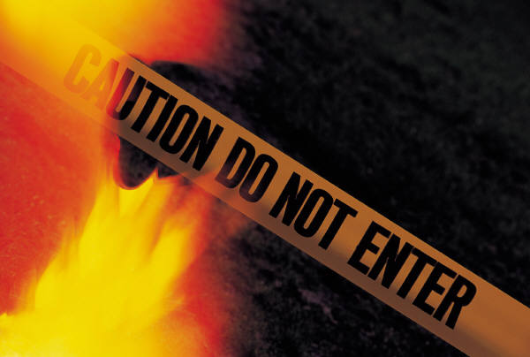
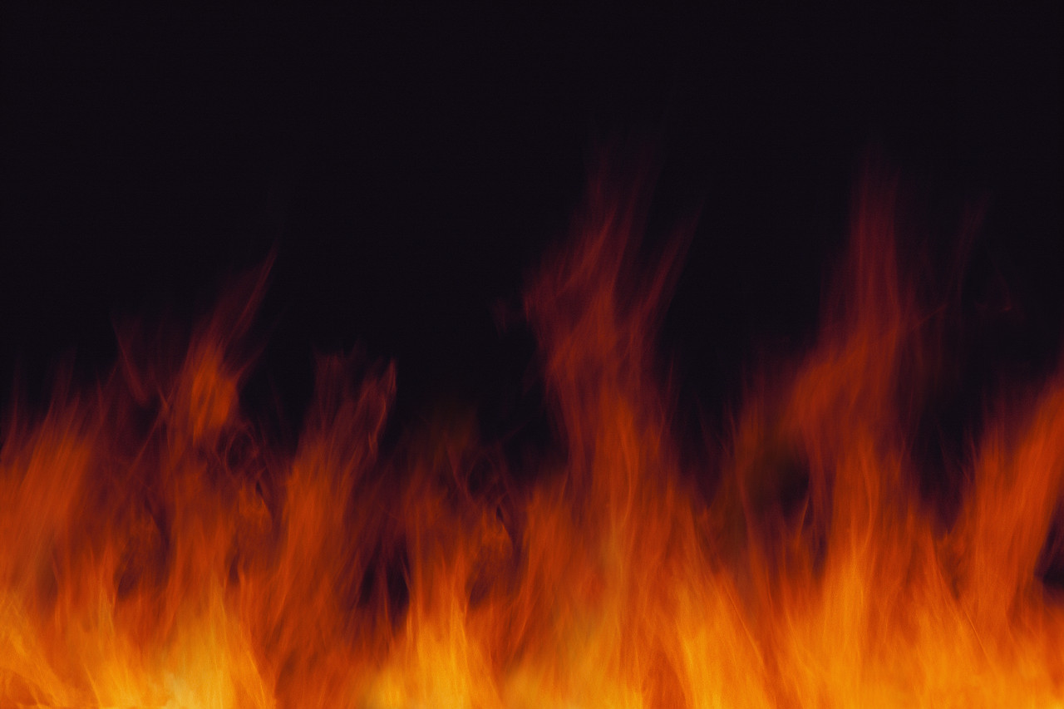
Fahrenheit 451
Author: Ray Bradbury
Student Name
School, Grade
Mrs. Z. Moore
Due Date

Slide 2
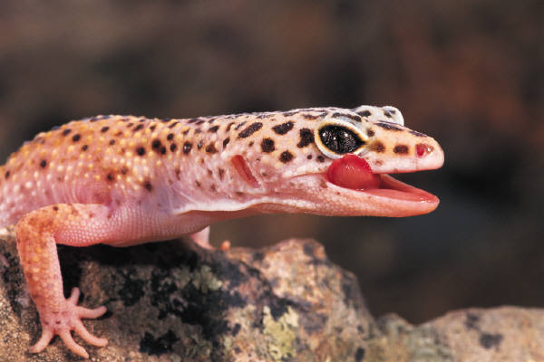
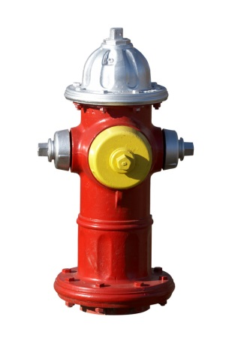
Table of Contents The following slides can be filled out and put in the order that allows your presentation to flow more easily. The themes &symbols are suggestions,. You may select your own. The symbols you select should be seen and an integral part throughout the book. You may need more than one slide per topic in order to cover the content sufficiently.
Slide 13 Black Beetle
Slide 14 Python/Snake
Slide 15 Mechanical Hound
Slide 16 Colors
Slide 17 Sieve
Slide 18 Sand
Slide 19 Vocabulary
Slide 29 Section 1: Hearth and the Salamander (audio)
Slide 21 Section 2: Sieve and Sand (audio)
Slide 22 Section 3: Burning Bright (audio)
Slide 23 Works Cited
Slide 24 Images/Audios Cited
Slide 1: Title Page
Slide 2: Table of Contents
Slide 3: Historical Context
Slide 4: Ray Bradbury
Slide 5: Utopian vs. Dystopian Comparison/Contrast
Slide 4: Main Character Listing
Slide 5: Guy Montag & Mildred Montag
Slide 6: Clarisse McClellen & Fire Captain Beatty
Slide 7: Farber & Granger
Slide 8: Themes & Symbolism
Slide 9: Themes
Slide 10 Symbolism
Slide 11 Salamander
Slide 12 Hearth

Slide 3
Ray Bradbury

Slide 4
Historical Context

Slide 5
Utopian vs. Dystopian

Slide 6
Main Character Listing

Slide 7
Main Characters
Guy Montag
Mildred Montag

Slide 8
Characters
Clarisse McClellen
Beatty

Slide 9
Characters
Farber
Granger

Slide 10
Themes and Symbolism

Slide 11
Themes

Slide 12
Symbolism

Slide 13
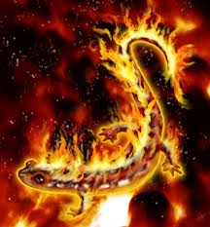
Salamander

Slide 14
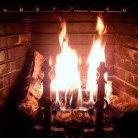
The Hearth
The hearth, or fireplace, is a traditional symbol of the home; the salamander is one of the official symbols of the firemen, as well as the name they give to their fire trucks. Both of these symbols have to do with fire, the dominant image of Montag’s life—the hearth because it contains the fire that heats a home, and the salamander because of ancient beliefs that it lives in fire and is unaffected by flames.
The hearth symbolizes home, and the salamander is one of the symbols of the firemen and the name they give to their fire trucks. Both of these symbols are connected to fire, which is the most significant image in Montag's life, the hearth because it contains the fire that heats a home, and the salamander because of ancient beliefs that it lives in fire and is unaffected by flames. Have a look at these study guides. The guides should give you some ideas about your question and help you with your work with this novel. http://www.literary-quotations.com/f/fah... http://classiclit.about.com/od/fahrenhei... http://www.sparknotes.com/lit/451/ http://www.gradesaver.com/classicnotes/t... http://www.cliffsnotes.com/WileyCDA/LitN... http://thebestnotes.com/booknotes/Fahren...
https://answers.yahoo.com/question/index?qid=20081106193807AAqIBhK the location for informationon this slide

Slide 15
Beetle

Slide 16
Python or Snake

Slide 17
Symbolic Colors

