Slide 1
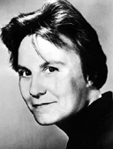
Harper Lee
(1926 - )

Slide 2
Nelle Harper Lee was born on April 28, 1926, in Monroeville, Alabama.
Lee is a descendent of Robert E. Lee, and her father was a newspaper editor and proprietor, a senator, and a lawyer.
One of Lee’s closest childhood friends was Truman Capote, whom Lee protected from bullies, since she was tougher than many boys.
In high school, Lee developed an interest in English literature and she went to the Huntington College to pursue studies in English.

Slide 3
Later, she transferred to the University of Alabama to study law, but eventually expressed that writing was her true passion.
After a summer in Oxford University in England, Lee dropped out of school to move to New York to pursue a career in writing.
In 1949, 23-year-old Harper Lee worked for airlines in New York city as a ticket agent to support herself.
She later befriended a Broadway composer and his wife, the Browns, who gave her a generous Christmas gift—they offered to support her for one year so she could write.

Slide 4
During that time, she composed To Kill a Mockingbird.
With the help of her editor and agent, she finished the novel in 1959.
Later that year, Lee went to Kansas to help her friend Truman Capote research the murder of the Clutter family; he was writing about the incident for The New Yorker.
She helped him conduct interviews of people impacted by the murder and the suspects themselves.

Slide 5
Capote compiled their research and interviews into the book In Cold Blood.
In the meantime, To Kill a Mockingbird became a very popular book, praised by the Literary Guild.
The following year, the novel won a Pulitzer Prize and several other literary awards.
In 1962, a screenplay based on the book was made into a movie starring Gregory Peck. Lee was on set during the making of the movie and granted interviews during that time.

Slide 6
By the mid-1960’s, Lee was reportedly working on a second novel, but it was never published.
Lee accepted a position on the National Council of the Arts at the request of President Lyndon Johnson.
Since the 1970’s, Harper Lee has retreated from public life, refusing interviews about her novel.
She is currently living in New York City, active in her church and community, and visits her sister in Monroeville.

Slide 7
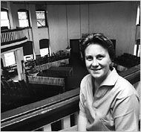
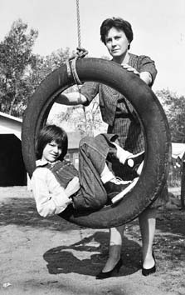
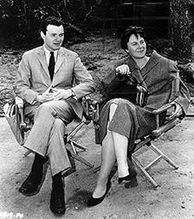
Harper Lee in the courthouse in Monroeville, Ala., May 1961.
Harper Lee with the actress who played Scout
Harper Lee with producer Alan J. Pakula in a 1962 publicity photo for the film of To Kill a Mockingbird.

Slide 8
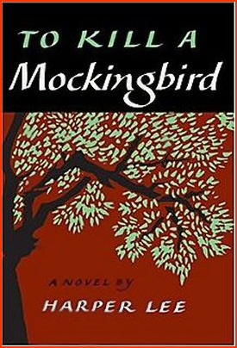
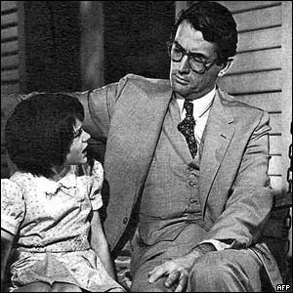
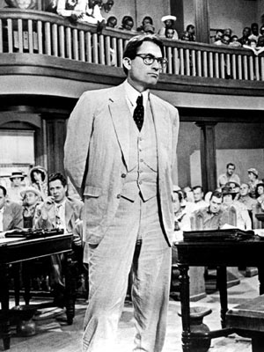
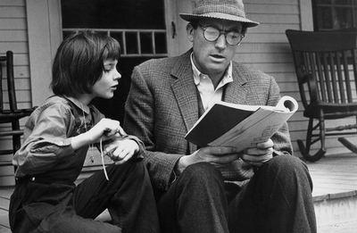
Cover of the first edition of the novel
Images of Gregory Peck as Atticus Finch and Mary Badham as Scout.

